Slide 1
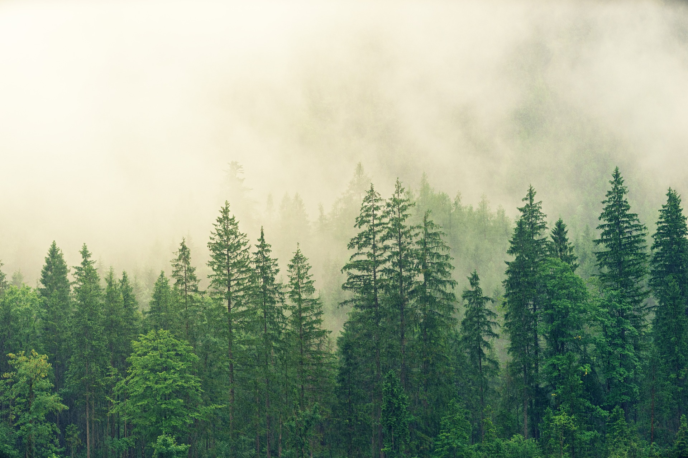
THE FOREST IN CAMBODIA
In 2010 cambodia had 7.22 Mha of natural forest, exteending over 42% of its land area.

Slide 2
THE FOREST IN CAMBODIA
In 2021 cambodia it lost 14 Kha of natural forest, equivalent to 83.2mt of CO2 emissions.

